Slide 1
Potential Life Insurance Clients
Grace Seo

Slide 2
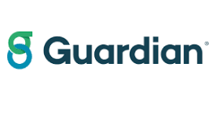
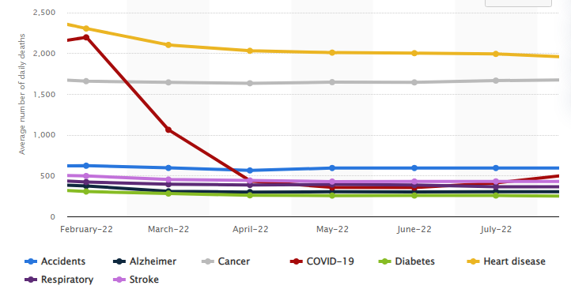
Guardian Life Insurance
Insurance company that provides life insurance, along with dental, disability and other options of insurance
Stroke is one of the leading causes of death in the U.S.
Helping the stakeholders avoid potential clients who may cost more down the road
More at risk of getting strokes
https://www.statista.com/statistics/1254560/leading-causes-of-death-in-the-us-average-number-daily/

Slide 3
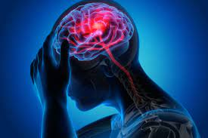
Intro to Data
Dataset consisting of around 5000 patients with various parameters
Target variable of stroke or no stroke
Other features
gender, age, various diseases, and smoking status

Slide 4
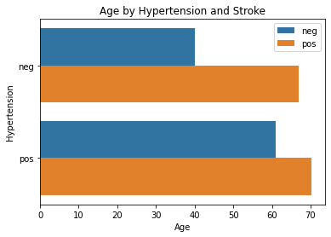
Age by Hypertension/Stroke
Graph of age grouped by hypertension and stroke
Slight difference between the two groups of pos and neg hypertension w/ stroke
Younger people seem to be more healthy
Older people tend to either have had a stroke and/or hypertension
Stakeholders should take caution insuring older clients, especially with hypertension
Notes:
To begin exploring the data I made various graphs to show relationships between the features. This graph shows the age of the individuals groups by hypertension and stroke
Just a slight difference between the two groups of negative and positive hypertension who have had strokes
The younger people seem to be more healthy as they have no hypertension and have not had a stroke.
Older people tend to either have had a stroke and/or hypertension
Stakeholders should take caution insuring older clients, especially with hypertension

Slide 5
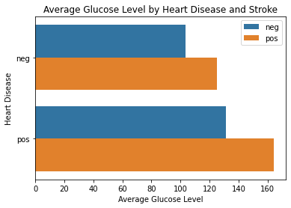
Glucose Level by Heart Disease/Stroke
Graph of average glucose level grouped by heart disease and stroke
Those who have had heart disease have higher glucose levels
Those with heart disease and high glucose level seem to get strokes
Stakeholders should try to avoid clients with heart disease and high glucose levels
Notes:
Those who have had heart disease all have higher glucose levels than their respective counterparts who have not
Those who have had heart disease along with a significant high glucose level seem to get strokes

Slide 6
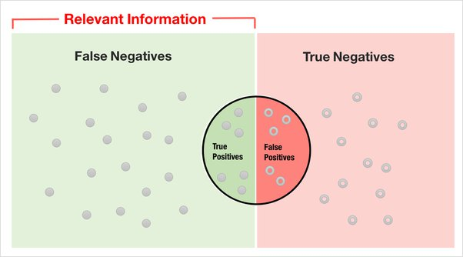
Intro to Model
Best model:identifies individuals to avoid
Produces small false neg and high true pos rates
Best to avoid false negatives: individuals who have had strokes as not having strokes, leading to loss of profit
True positives: truly have not had strokes
Model would hopefully predict best clients who would not have strokes
https://thereaderwiki.com/en/Sensitivity_and_specificity
Notes:
Best model with stakeholders best interests in mind is one that identifies individuals to avoid
The model I chose produced small false neg and high true positive rate
Best to avoid false negatives as it indicates individuals who have had strokes as not having strokes, leading to loss of profit
True positives are individuals indicated to have had strokes who have actually had strokes
True positives are those who truly have not had strokes

Slide 7
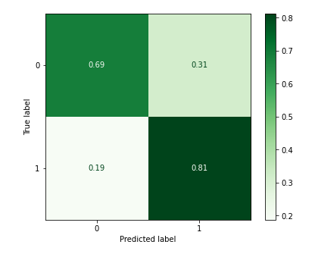
Pros and Cons
Pros:
False negative rate of 0.19 which is fairly low
True positive rate of 0.81 being decently high
Cons:
Accuracy of 0.70
Avoiding false negatives is slightly more prioritized
Extremely imbalanced data
Identify issue sampling methods
Notes:
Going into the pros and cons of our model
The pros are that the model produced a false negative rate of 0.19 which is fairly low compared to the other models produced. And as a result it also produced a decent true positive rate of 0.81
The cons, however, would be that the accuracy of 0.70 isnt as high as desired and the target class is extremely imbalanced, but for an insurance company, avoiding false negatives is more prioritized

Slide 8
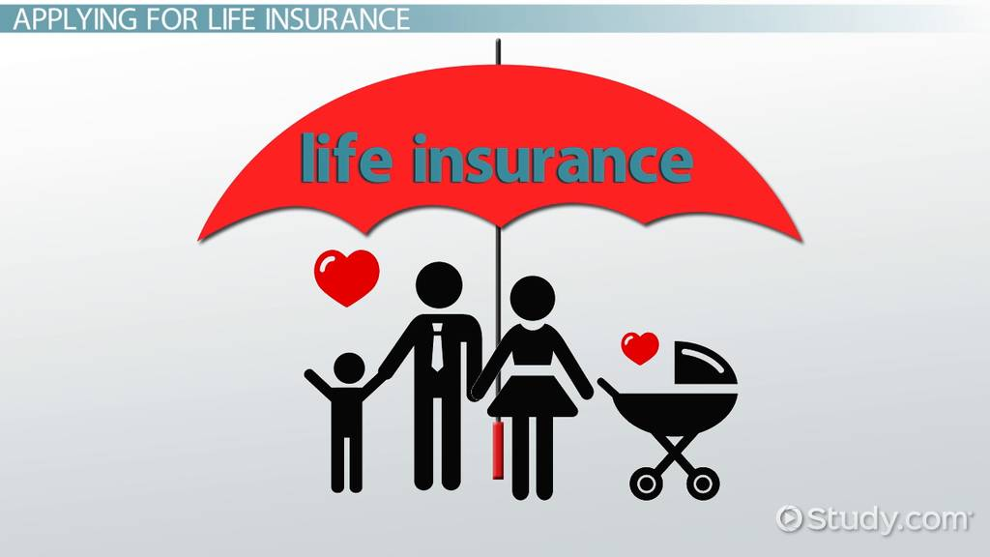
Final Recommendations
To optimize profits:
Avoid those with heart disease and high glucose
If of older age with hypertension, should take caution
Utilize model for potential clients predicted to not have strokes who won’t cost the company
Notes:
To optimize profits, it would be beneficial to avoid signing clients that have heart disease along with high glucose. If the clients are of older age with hypertension the company should take caution in insuring them. From there we can use the conducted model for potential clients predicted to not have strokes and steering clear of those that would.

